Slide 1


Computer Architecture Spring 2020
Hamed Farbeh
farbeh@aut.ac.ir
Department of Computer Engineering
Amirkabir University of Technology

Slide 2
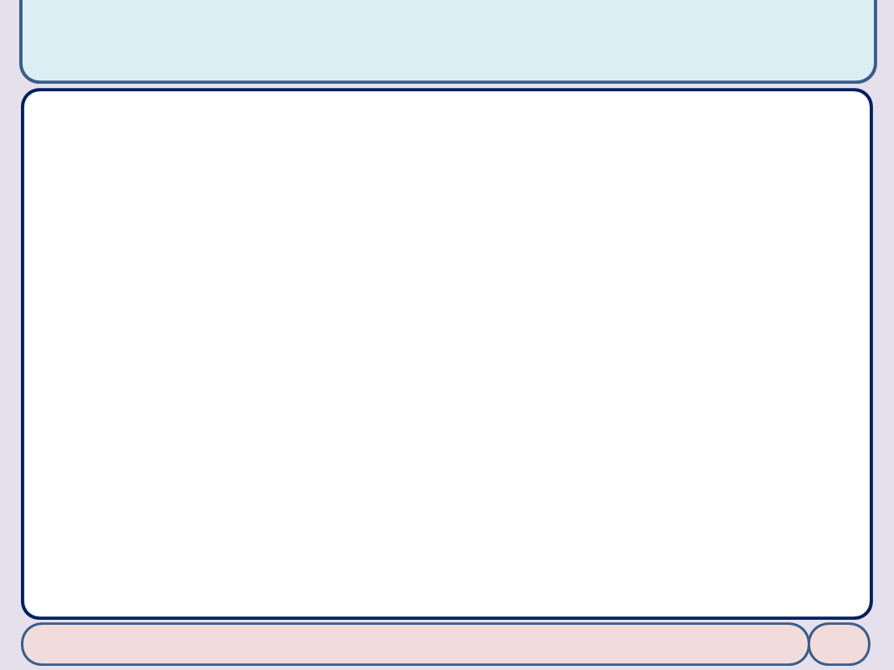

Copyright Notice
Lectures adopted from
Computer Organization and Design: The Hardware/Software Interface, 5th edition, David A. Patterson, John L. Hennessy, MK pub., 2014
Chapter 5: Large and Fast: Exploiting Memory Hierarchy
Computer Architecture, Spring 2020, AUT, Tehran, Iran

Slide 3
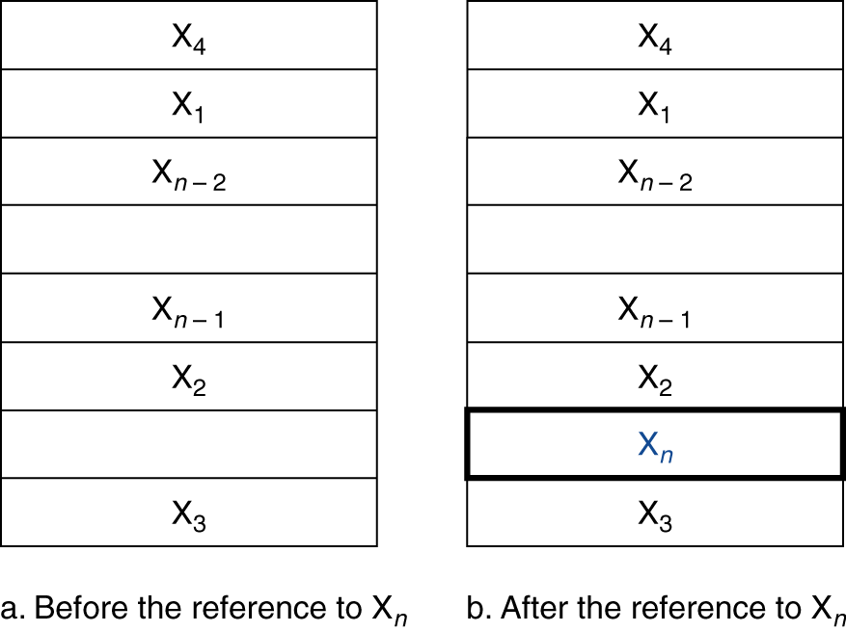
Cache Memory
Cache memory
The level of the memory hierarchy closest to the CPU
Given accesses X₁, …, X_{n–1}, X_{n}
How do we know if the data is present?
Where do we look?
Computer Architecture, Spring 2020, AUT, Tehran, Iran

Slide 4
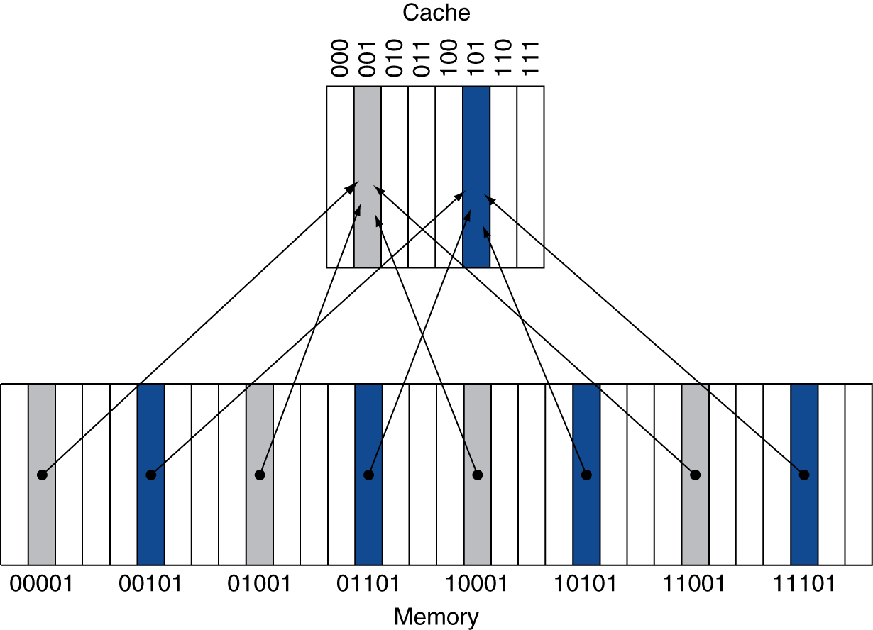
Direct Mapped Cache
Location determined by address
Direct mapped: only one choice
(Block address) modulo (#Blocks in cache)
#Blocks is a power of 2
Use low-order address bits
Computer Architecture, Spring 2020, AUT, Tehran, Iran

Slide 5
Tags and Valid Bits
How do we know which particular block is stored in a cache location?
Store block address as well as the data
Actually, only need the high-order bits
Called the tag
What if there is no data in a location?
Valid bit: 1 = present, 0 = not present
Initially 0
Computer Architecture, Spring 2020, AUT, Tehran, Iran

Slide 6
Cache Example
8-blocks, 1 word/block, direct mapped
Initial state
Index | V | Tag | Data
000 | N
001 | N
010 | N
011 | N
100 | N
101 | N
110 | N
111 | N
Computer Architecture, Spring 2020, AUT, Tehran, Iran

Slide 7
Cache Example
Word addr | Binary addr | Hit/miss | Cache block
22 | 10 110 | Miss | 110
Index | V | Tag | Data
000 | N
001 | N
010 | N
011 | N
100 | N
101 | N
110 | Y | 10 | Mem[10110]
111 | N
Computer Architecture, Spring 2020, AUT, Tehran, Iran

Slide 8
Cache Example
Word addr | Binary addr | Hit/miss | Cache block
26 | 11 010 | Miss | 010
Index | V | Tag | Data
000 | N
001 | N
010 | Y | 11 | Mem[11010]
011 | N
100 | N
101 | N
110 | Y | 10 | Mem[10110]
111 | N
Computer Architecture, Spring 2020, AUT, Tehran, Iran

Slide 9
Cache Example
Word addr | Binary addr | Hit/miss | Cache block
22 | 10 110 | Hit | 110
26 | 11 010 | Hit | 010
Index | V | Tag | Data
000 | N
001 | N
010 | Y | 11 | Mem[11010]
011 | N
100 | N
101 | N
110 | Y | 10 | Mem[10110]
111 | N
Computer Architecture, Spring 2020, AUT, Tehran, Iran

Slide 10
Cache Example
Word addr | Binary addr | Hit/miss | Cache block
16 | 10 000 | Miss | 000
3 | 00 011 | Miss | 011
16 | 10 000 | Hit | 000
Index | V | Tag | Data
000 | Y | 10 | Mem[10000]
001 | N
010 | Y | 11 | Mem[11010]
011 | Y | 00 | Mem[00011]
100 | N
101 | N
110 | Y | 10 | Mem[10110]
111 | N
Computer Architecture, Spring 2020, AUT, Tehran, Iran

Slide 11
Cache Example
Word addr | Binary addr | Hit/miss | Cache block
18 | 10 010 | Miss | 010
Index | V | Tag | Data
000 | Y | 10 | Mem[10000]
001 | N
010 | Y | 10 | Mem[10010]
011 | Y | 00 | Mem[00011]
100 | N
101 | N
110 | Y | 10 | Mem[10110]
111 | N
Computer Architecture, Spring 2020, AUT, Tehran, Iran

Slide 12
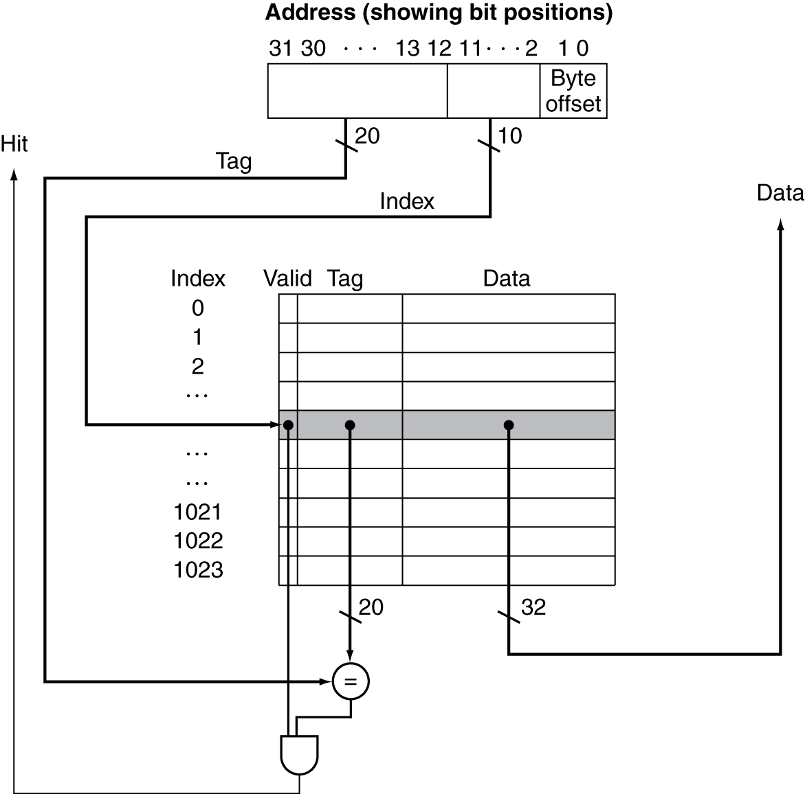
Address Subdivision
Computer Architecture, Spring 2020, AUT, Tehran, Iran

Slide 13
Example: Larger Block Size
64 blocks, 16 bytes/block
To what block number does address 1200 map?
Block address = ⎣1200/16⎦ = 75
Block number = 75 modulo 64 = 11
31
10
9
4
3
0
Tag
Index
Offset
22 bits
6 bits
4 bits
Computer Architecture, Spring 2020, AUT, Tehran, Iran

Slide 14
Block Size Considerations
Computer Architecture, Spring 2020, AUT, Tehran, Iran

